Slide 1
BOOK SALES ANALYSIS

Slide 2
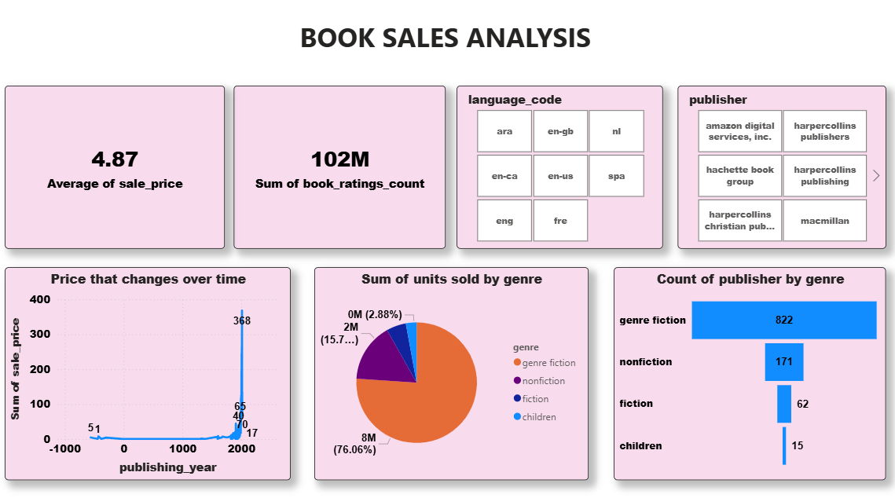

Slide 3
Executive Overview & Filter Context
Goal: Analyze book sales performance across different filter selections (likely by language or publisher selection, as indicated by the active filters).
Key Insight: Filters have a dramatic impact on metrics, showing distinct market segments in terms of volume, value, and genre preference.

Slide 4
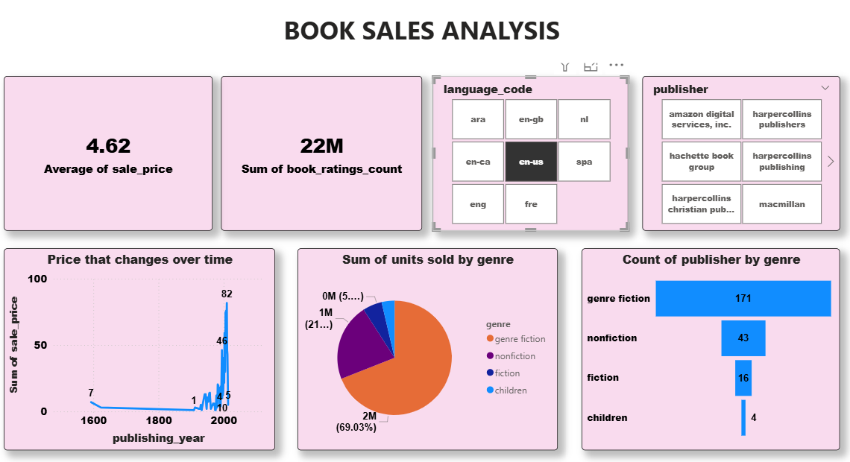

Slide 5
Volume & Value Metrics: The Impact of Scale
Average Sale Price :
The overall average price is 4.87 (All Data).
Highest Price: The books associated with the HarperCollins Publishers filter are the most expensive, with an average price of 6.28.
Lowest Price: Books filtered by en-ca (Canadian English) are significantly cheaper at only 2.49, less than half the overall average.
Total Ratings Count (Market Size Proxy):
English Language Dominance: The 'All Data' view has a massive 102M total ratings, suggesting a highly engaged global market.
en-us (US English) accounts for a large segment with 22M ratings.
Low Volume Filters: Specific publisher filters (e.g., Macmillan, HarperCollins) and the en-ca filter show much smaller, more focused markets (4M to 835K ratings).

Slide 6
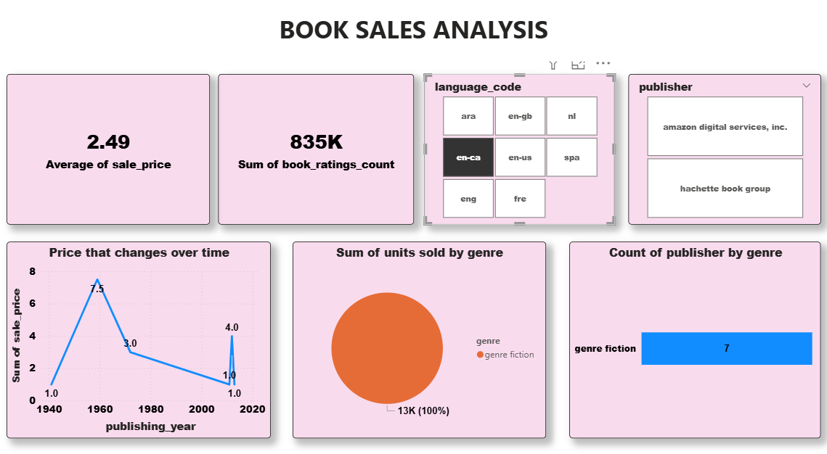

Slide 7
Genre Analysis: Fiction vs. Non-fiction Dominance
Units Sold by Genre (Volume):
Across all views, Fiction (orange/red) is the dominant genre in terms of units sold.
Fiction Extremes: The en-ca filter shows 100% Fiction (13K units), while the Macmillan filter is close behind at 92.43% Fiction (310K units).
Genre Mix: The HarperCollins Publishers filter shows the most balanced mix, with Fiction at 57.66% and Nonfiction (purple) at 31.33% (193K units), indicating this publisher has a stronger Nonfiction catalog than the others.
Publisher Concentration (Count of Publisher by Genre):
Fiction is King: The number of publishers working in the Fiction genre is overwhelmingly higher across all views (e.g., 822 in All Data).
The ratio of Fiction to Nonfiction publishers remains high (e.g., 822 to 171 in All Data), confirming that Fiction is the most saturated and published market segment.

Slide 8
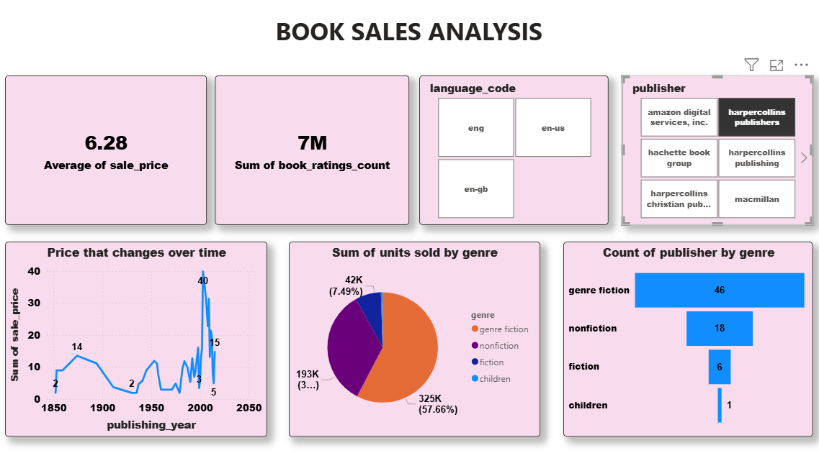

Slide 9
Price Trends Over Time: Volatility & Peaks
Overall Trend (All Data):
Shows extreme price volatility, particularly a huge spike to 368 around the year 2000. This is likely an outlier or a limited sample size driving the Sum of sale price high in that year.
Modern Era (Post-2000) Observations:
HarperCollins Publishers (Image 2) shows an intense price peak of 40 in the post-2000 era, suggesting high-priced releases in their catalog.
en-us (Image 4) shows a peak of 82 around 2000, indicating premium pricing in the US market around that time.
en-ca (Image 1) shows a distinct, relatively low peak of 7.5 around 1960, and a smaller peak of 4.0 around 2020, demonstrating a consistently lower price ceiling compared to the global and US markets.

Slide 10
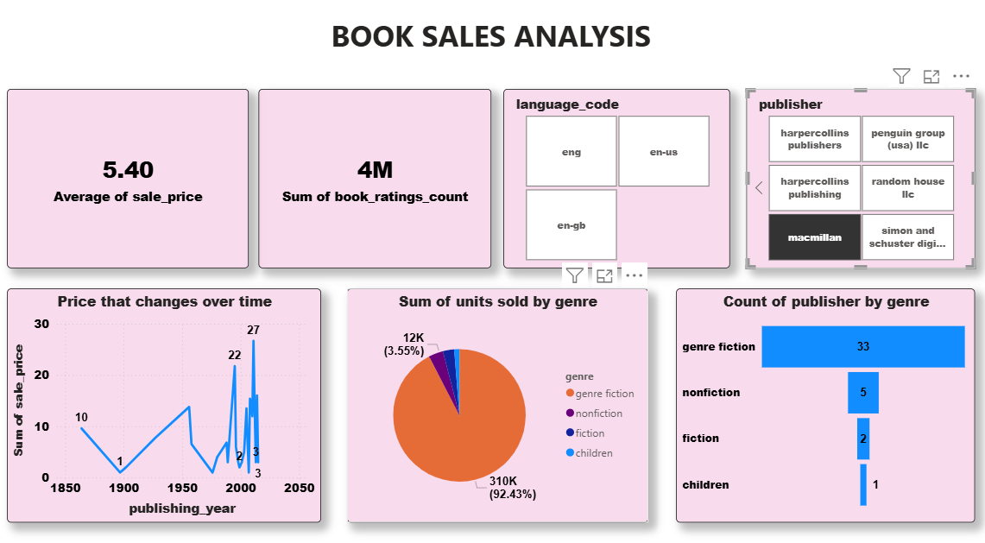

Slide 11
Key Takeaways & Recommendations
Price Differentiation: The Canadian English (en-ca) market is significantly more price-sensitive, demanding a review of pricing strategies for that region.
Genre Focus: Fiction is the overwhelmingly dominant category for both sales volume and publisher count. Focus marketing efforts and acquisitions primarily on the Fiction segment.
Publisher Strategy: HarperCollins Publishers stands out for premium pricing ($6.28 Avg.) and a relatively high contribution from the Nonfiction genre, indicating a successful strategy in a more niche, high-value segment.

